Slide 1

CODE RAFACTORING AND BUG FIXING

Slide 2
About me
My name E B Shobha Rani I Completed My Graduation Bsc In
Mathematics . I'm passionate about data because it holds the key to
unlocking valuable insights and understanding complex phenomena.
Learning Data Science allows me to harness the power of data to solve
real-world problems, make informed decisions, and drive positive
change. It's an exciting journey where I can explore patterns, uncover
trends, and contribute to innovation in diverse fields.
Github: https://github.com/BalaShobhaRani
Linkidin: http://www.linkedin.com/in/eerlabalashobharani/

Slide 3
OBJECTIVE: Refactor and debug the existing Note Taking Application codebase to ensure proper functionality while maintaining its structure. Identify and fix bugs to improve application quality without rewriting it entirely
Form Submission : Corrected form action to “/”.
Flask Route : Changed “method” to “methods”.
Form Handling : Added logic for GET and POST requests.
Form Method : Specified HTML form method as “POST”
BUG FIXED : Incorrect Request Method Handling in Flask
ISSUE: The Flask route only handled POST requests ,resulting in a method not allowed error during initial page access.
Solution: Updated Flask route to allow both GET and POST methods using methods=[“GET”,”POST”] This
Change enables the application to handle all types of requests effectively

Slide 4
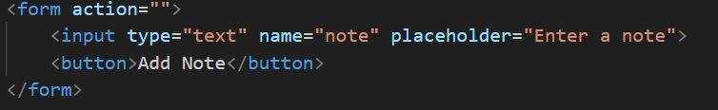
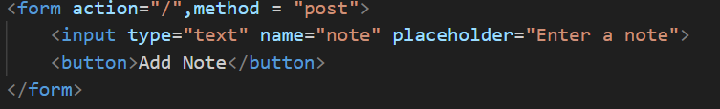
INCORRECT HTML METHOD
Solution: Added method = ‘POST’ to the form tag to ensure the form
data is submitted using the POST method ,crucial for handling note additions

Slide 5
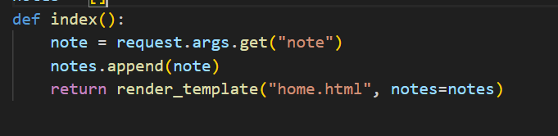
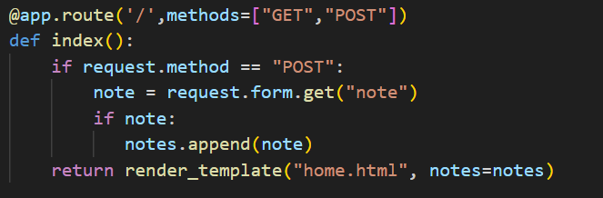
INCORRECT RETRIEVAL OF NOTE IN FLASK ROUTE Issue: The code used requests args .get(“note”) to retrieve notes from the form suitable for GET requests but not for forms submitted via POST
Solution: Updated the note retrieval in the flask route to use request.form(“note”) ensuring proper handling of note submission
Via POST request

Slide 6
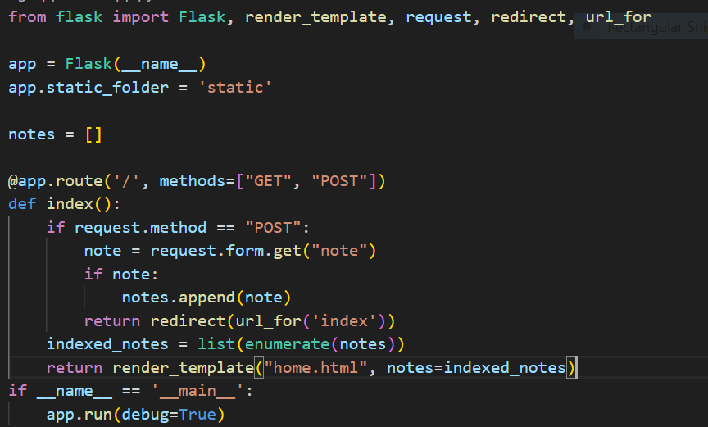
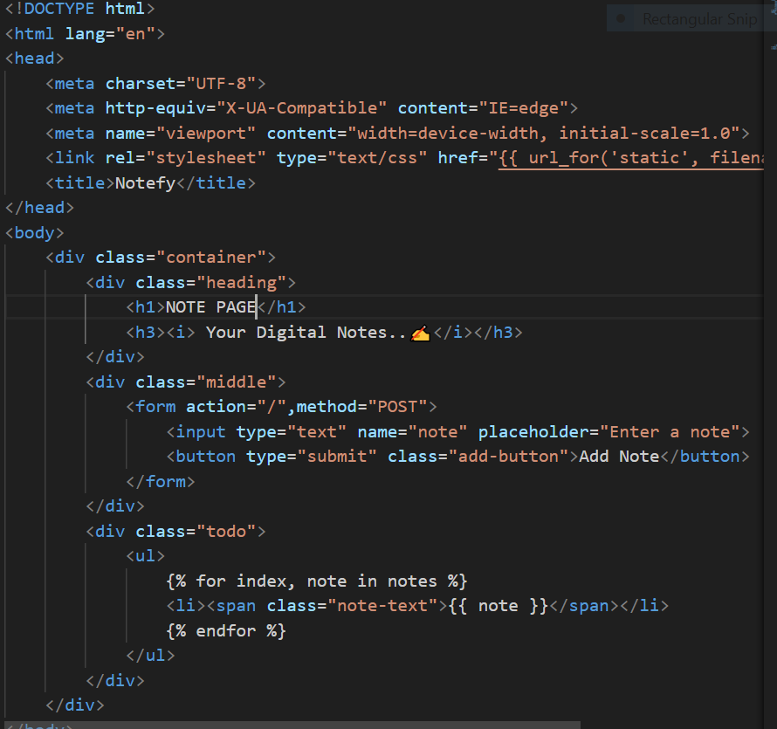
Final FLASK & HTML Code

Slide 7
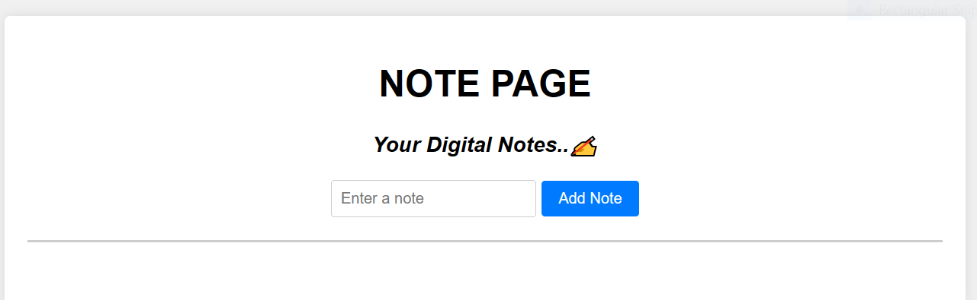
Conclusion: The Note Taking Application’s Pytho,Flask and HTML
Codebase underwent vital improvement and Bug fixes enhance
functionality and security
Issue with form submission,Flask routes ,HTML form methods and
Note retrieval were identified and resolved
The final Flask and HTML code reflect these changes results more polished and user_friendly Note Taking Application

Slide 8
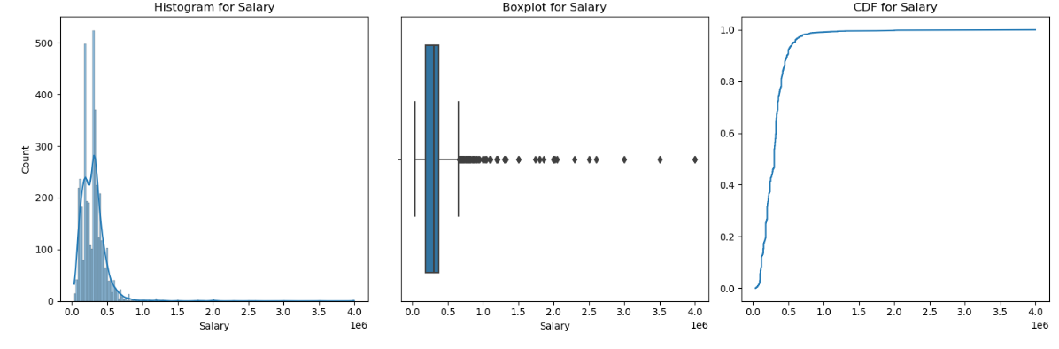
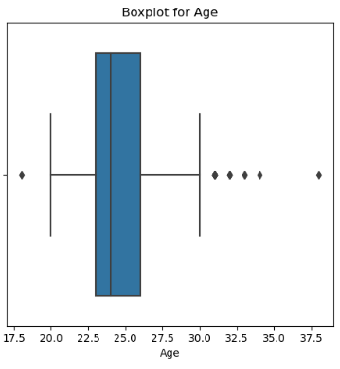
Exploratory Data Analysis 1.Univariate Analysis - Numerical Features (Contionuous):
Salary :
Histogram The data exhibits significant Left skewness
Box Plot There is a notable concentration of data points with high salaries, as depicted by the box plot
CDF The cumulative distribution function (CDF) reveals a high degree of skewness in the data with considerable deviation from a normal distribution age compared to other data points.
Ag e Age
Boxplot: The box plot indicates the presence of 4 students with very high ages and one with
very low age compared to other. The majority of students' ages ranged between 22 and 25
approximately 25
age compared to other data points.

Slide 9
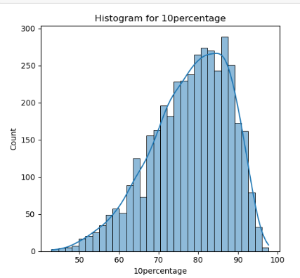
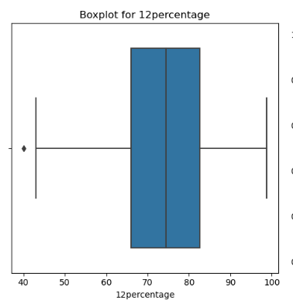
10percentage: 12percentage:
Boxplot The plot illustrates a scarcity of students with low percentages, with the majority scoring between 69% and 84%. The peak frequency occurs at 70%, and the average score is around 74%. plot indicates only one data point with an extremely low score.
Histogram The histogram depicts a scarcity of students with low percentages, with the majority falling within the 75% to 90% range. The peak frequency occurs at 78%, and the average score hovers around 77%.The presence of a few extreme outliers is evident from the box plot.

Slide 10
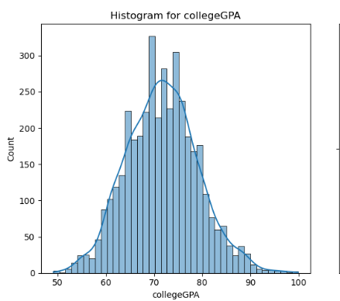
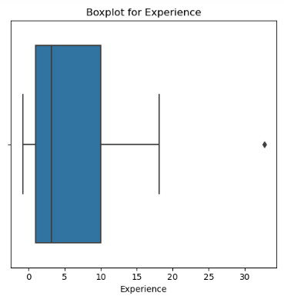
collegeGPA: Experience:
Boxplot The data is positively skewed i.e there exists larger number of respondents are below 10 years experienceThere are one value with more Experience i.e outliers
Histogram The majority of students had GPAs ranging between 63% and 78%. The highest frequency of students scored 70%, and the average GPA was 74%.It have both low and high extreme values within the dataset

Slide 11
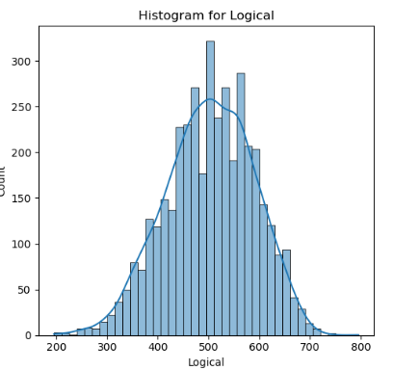
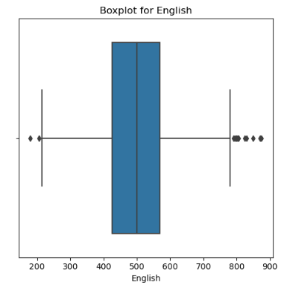
English, Logical, Quant, Computer Programming, Electronics & Semiconductors
Observation:The dataset analysis across various subjects reveals distinct patterns. In English exams, approximately half of the students scored below 500, with scores predominantly ranging from 389 to 545 and a noticeable presence of extreme values. Similarly, in Logical exams, a significant portion of students scored below 500, with scores concentrated between 454 to 584, displaying both lower and higher extreme values.

Slide 12
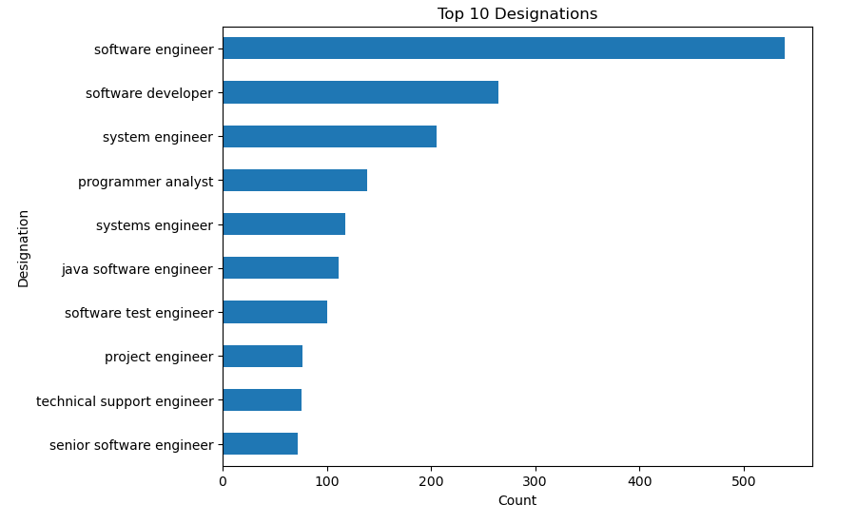
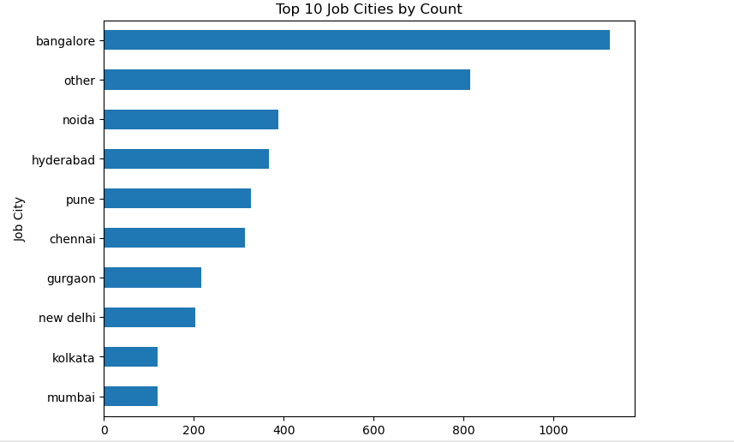
Categorical Features Designnation: JobCity:
Barplot The dataset observations across various categories provide valuable insights into the demographics and educational backgrounds of individuals. In terms of Designation, Software Engineer emerges as the most prevalent designation, followed by System Engineer and Software Developer,
Job City preferences, Bangalore stands out as the most favorable city for job placements, followed by Noida, Hyderabad, and Pune, while Mumbai and Kolkata are less preferred

Slide 13
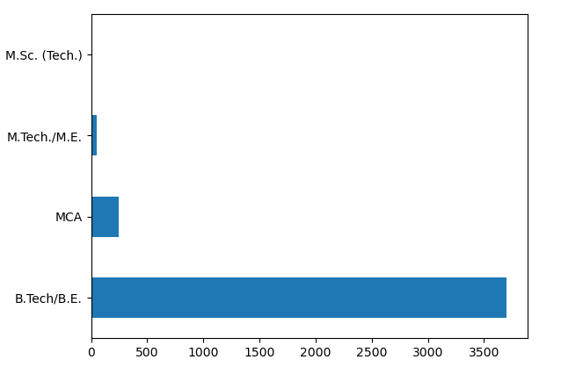
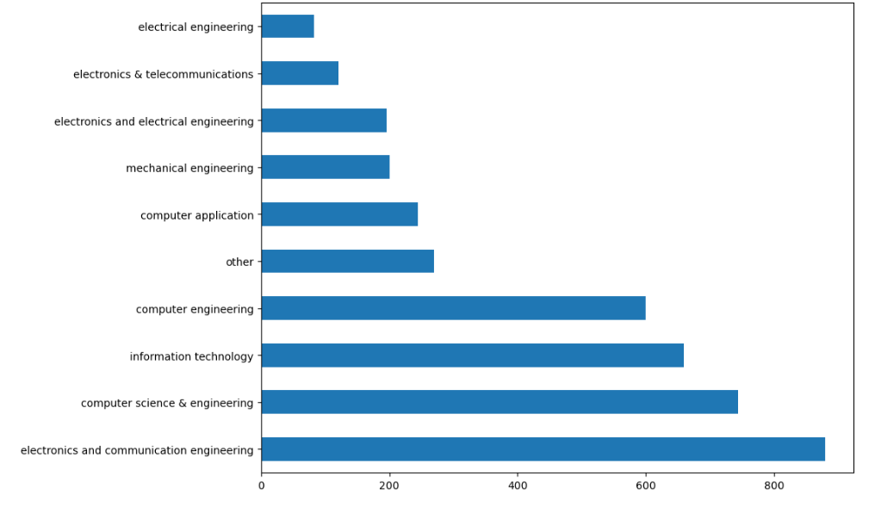
Degree: Specialization:
Barplot Most students have pursued a B.Tech degree, with minimal representation from M.Sc(Tech) graduates.
Observation: Most of the students have done their Specialisation in electronics and communication engineering, computer science & engineering

Slide 14
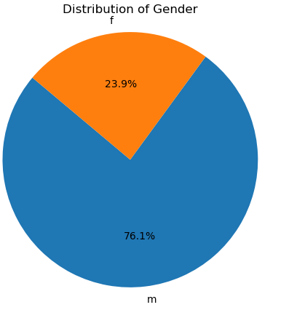
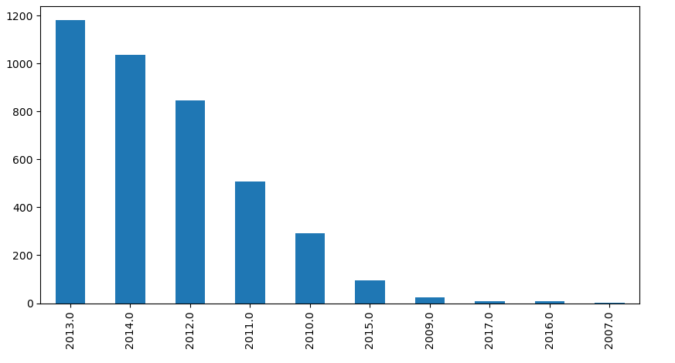
Gender: GraduationYear:
Piechart The dataset is not balanced in terms of gender as the population of Male is really larger as compared to the female one
Barplot Maximum number of students were graduated in 2013, followed by the year 2014 and 2012

Slide 15
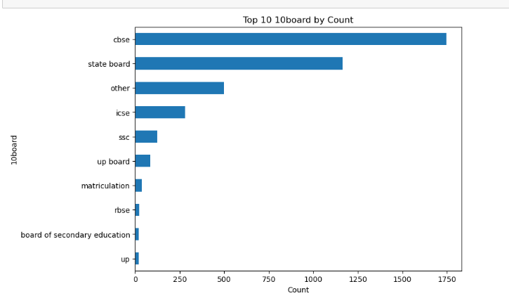
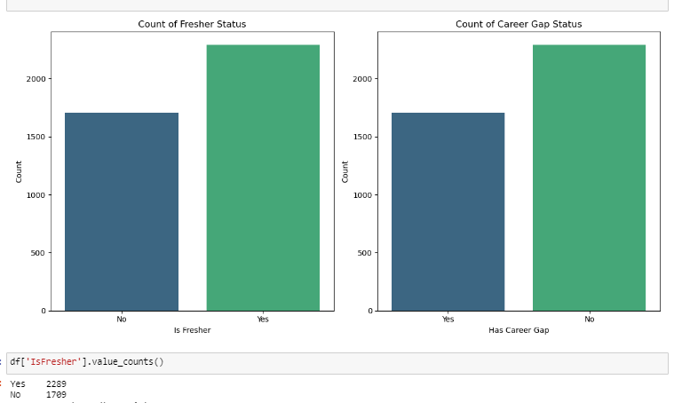
10thboard : IsFresher:
Barplot CBSE emerges as the most common school board for both 10th and 12th grades,
Bar plot The majority are categorized as "No Career Gap," implying that they transitioned directly from education to employment without any significant gap.There's a comparatively smaller count of individuals categorized as having a "Career Gap"

Slide 16
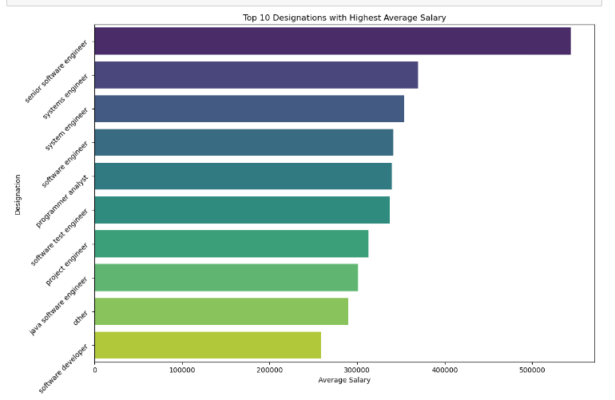
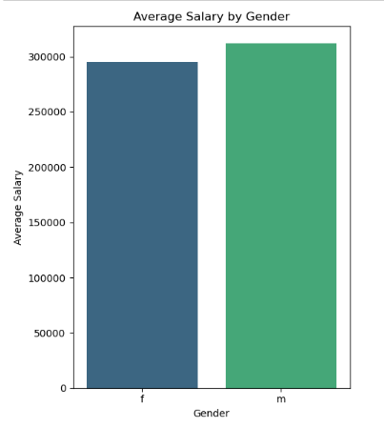
Bivariate analysis Designations & Salary : Gender & Salary :
Barplot Bar plot shows the maximum salary for each Designation. Senior Software Engineer has the highest salary but they also has the maximum standard deviation in their salary. software developer has salary lower than average salary.
Barplot The average salary for both male and female is approximately equal and it implies that there was no gender bias in terms of salary. It is also plausible to say that Female's get salary below the overall average salary

Slide 17
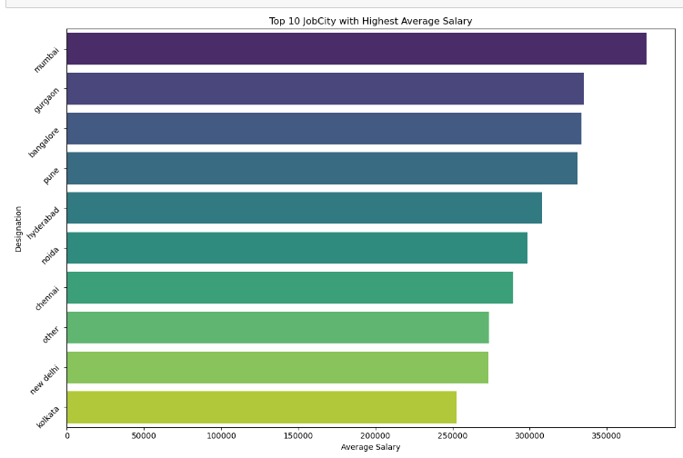
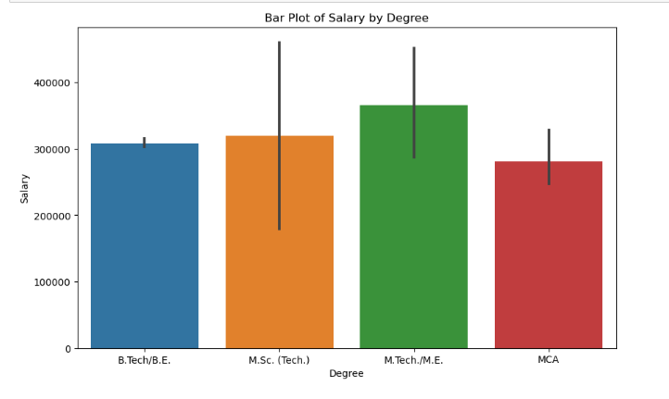
JobCity & Salary : Degree & Salary :
Barplot Bar plot shows salary for each JobCity mumbai has highest salary and followed by gurgaon,banglore.
Box plot Box plot shows salary for Degree M.Tech/M.E graduates earning high salary than other graduates

Slide 18
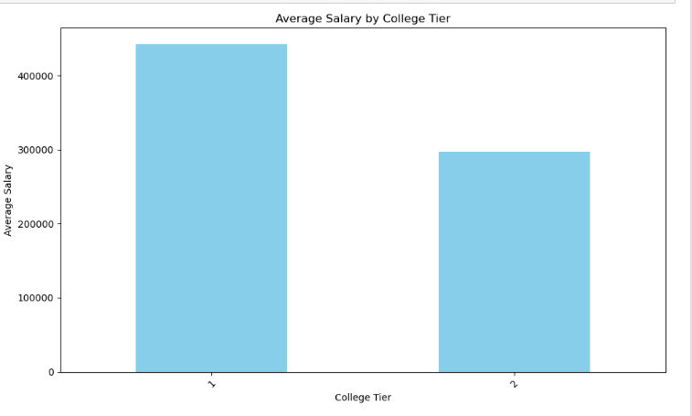
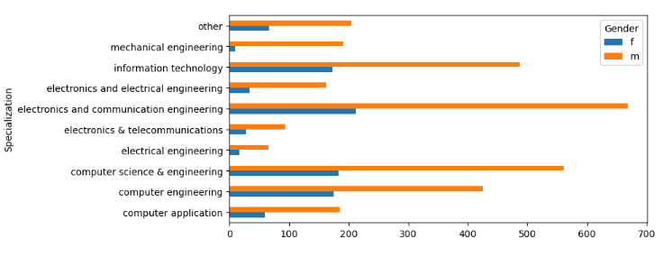
Specialization & Gender: CollegeTier & Salary :
Barplot Male participation is approximately double that of females across all specializations, with fewer females opting for mechanical and electronics.
Bar plot Tier 1 colleges offer higher salaries compared to Tier 2 colleges, and cities in Tier 1 and Tier 2 offer similar salaries to students.

Slide 19
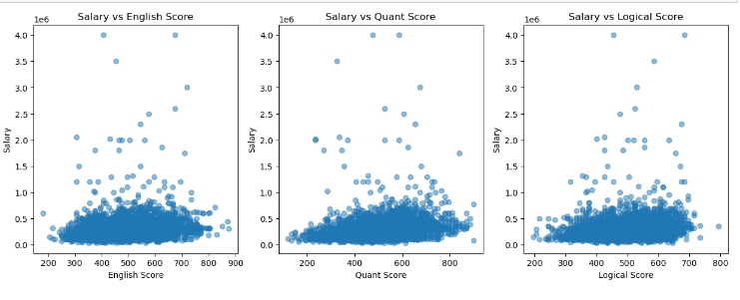
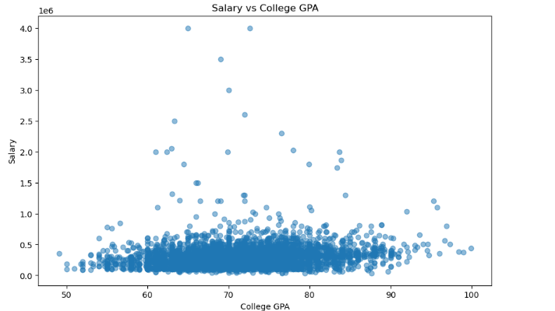
Scores & Salary: CollegeTier & Salary :
Scatterplot There does not exist any correlation The scatters plots above gives adequate evidence that salary is not effected by any of the above scores.
Scatter plot college GPA scores, does not correlate with Salary.

Slide 20
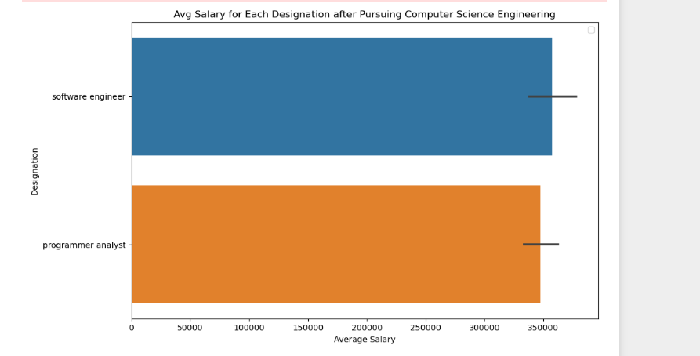
RESEARCH OUTCOMES “Times of India article dated Jan 18, 2019 states that “After doing your Computer Science Engineering if you take up jobs as a Programming Analyst, Software Engineer, Hardware Engineer and Associate Engineer you can earn up to 2.5-3 lakhs as a fresh graduate.”
The analysis begins by grouping the dataset by job designation, calculating the mean of salaries for each job role. This provides insights into salary distribution across different designations. Notably, Software Engineers have the highest mean salary and indicating higher earnings compared to Programmer Analyst

Slide 21
CONCLUSION:
1. Designation Influence on Salary: Senior Software Engineers command the highest salaries, but also exhibit the highest salary variability, indicating potential for high earnings but also risk. Conversely, Software Developers and Technical Support Engineers generally receive below-average salaries, suggesting less lucrative career paths.
2. Gender Disparity:While the average salaries for both genders are similar, females tend to earn below the overall average, indicating a gender pay gap that warrants further investigation and potential corrective measures.
3. Academic Performance Impact: No significant correlation exists between academic scores (10th, 12th, College GPA) and salary, suggesting that while academic qualifications are important, they may not directly translate to higher earnings in the job market..
4. Skill Proficiency: English, Quants, and Logical scores do not seem to influence salary significantly, indicating that other factors such as job role responsibilities or industry demand may play a more significant role in determining compensation.
5. Gender and Specialization:Male participation is notably higher across all specializations, with fewer females opting for mechanical and electronics fields, suggesting potential gender-based career preferences or societal influences.
6. College Reputation:Tier 1 colleges tend to produce graduates who command higher salaries compared to Tier 2 colleges, indicating the importance of institutional reputation in shaping career outcomes.
7. City Tier Impact: Cities in Tier 1 and Tier 2 offer similar salary prospects to students, suggesting that while city choice may impact lifestyle and job availability, it may not significantly affect earning potential.
“’In summary, while factors like college reputation, and career choice strongly influence salary levels, gender disparities and academic performance do not appear to be as decisive. This underscores the complexity of salary determinants, suggesting a multifaceted interplay of factors in shaping compensation outcomes.””

Slide 22

THANK YOU

